Slide 1


Azure Kubernetes Service
Accelerate Growth on Cloud

Slide 2
Agenda
Demo
Automation Procedure
Tools used
Azure Pipeline
What is Azure Container Registry

Slide 3
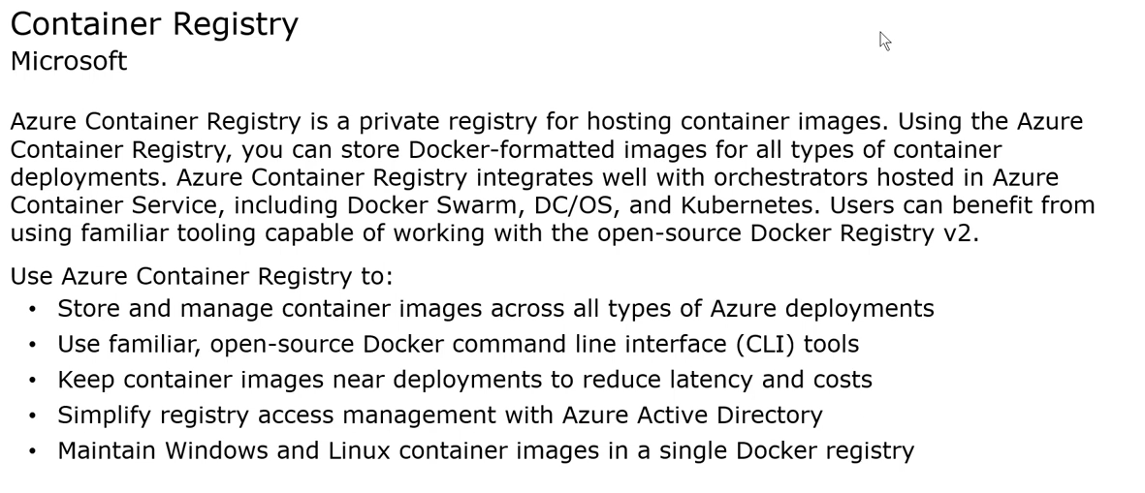
What is Azure Container Registry
Copyright (c) 2019. Blazeclan Technologies Pvt. Ltd.

Slide 4
Explain the Integration of Tools for Deployment
Copyright (c) 2019. Blazeclan Technologies Pvt. Ltd.

Slide 5
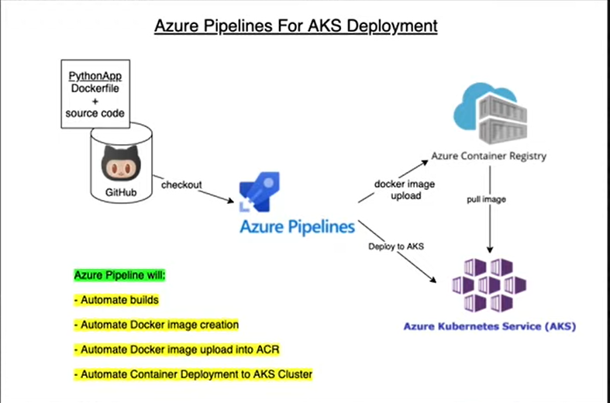
Pipeline
Copyright (c) 2019. Blazeclan Technologies Pvt. Ltd.

Slide 6
DEMO on Automation
Copyright (c) 2019. Blazeclan Technologies Pvt. Ltd.

Slide 7

thank you
Notes:
Do Not edit this Slide, This is Thank you in motion

